Slide 1
Error and Exception Handling
Dirk Riehle, FAU Erlangen
ADAP B05
Licensed under CC BY 4.0 International

Slide 2
Agenda
The common bug
A system model
Error detection
Error signaling
Error handling
Service failure
Homework

Slide 3
Focus
In this lecture, we focus on a subset of [A+04], specifically
Errors caused by software faults that are
Always development, internal, human-made faults
Typically non-malicious, non-deliberate
Error detection by concurrent detection
Error handling using any matching strategy
In other words, errors caused by the common bug
[A+04] Avižienis, A., Laprie, J. C., Randell, B., & Landwehr, C. (2004). Basic concepts and taxonomy of dependable and secure computing. IEEE Transactions on Dependable and Secure Computing 1(1), 11-33.

Slide 4
1. The Common Bug

Slide 5
Catching the Common Bug
Best done during development (earlier is better)
But you can’t avoid errors at runtime

Slide 6
Deliberately Bad Java Example [1]
public int readInt(File f, Buffer b) throws ParseException {
int result = 0;
try {
FileInputStream fis = new FileInputStream(f);
fis.read(b);
result = Integer.parse(b.toString());
} catch (Exception ex) {
// do nothing
}
if (result == 0) {
// there should never be “0” in file
System.out.println(“something went wrong!”);
return -1;
}
return result;
}
[1] Doesn’t compile; created for demonstration purposes only

Slide 7
Things Wrong With Example
General programming errors
Unclear preconditions; no assertions
No need for external buffer variable
No clean-up after resource use
Specific bad practices of error handling
Overloading of purpose of return value
Mismatch between method signature and behavior
System exception swallowed without logging
Inconsistent use of error codes and exceptions
Unprofessional logging / error message useless

Slide 8
Dependability and Fault Tolerance
If bugs are inevitable, how to handle them?

Slide 9
2. A System Model

Slide 10
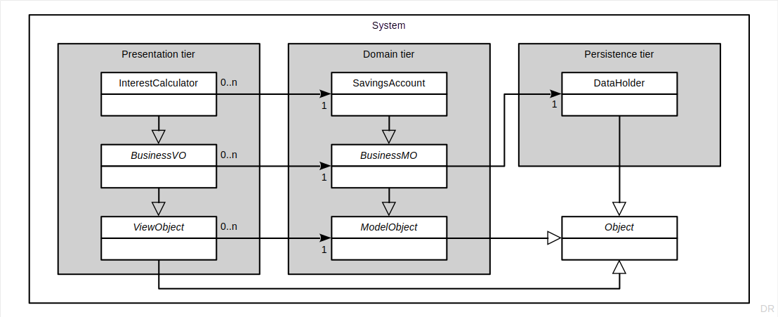
System Architecture (Runtime Tiers)

Slide 11
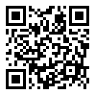
How Many Objects at Runtime? [1]
[1] Also https://forms.gle/aV3yF6KTM1odzJRFA

Slide 12
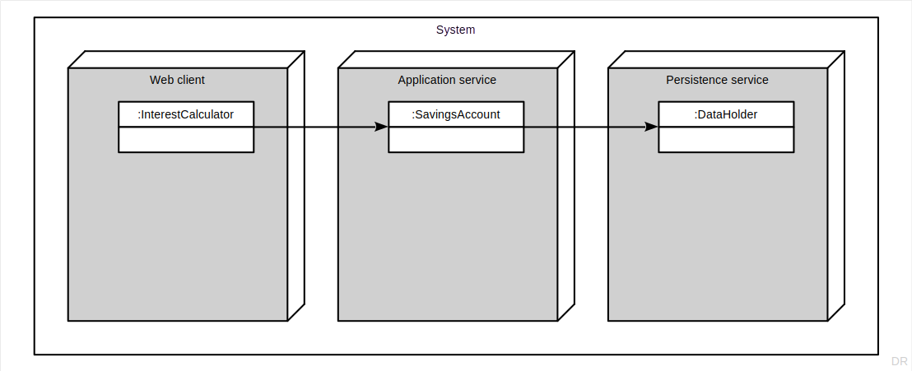
Runtime Objects

Slide 13
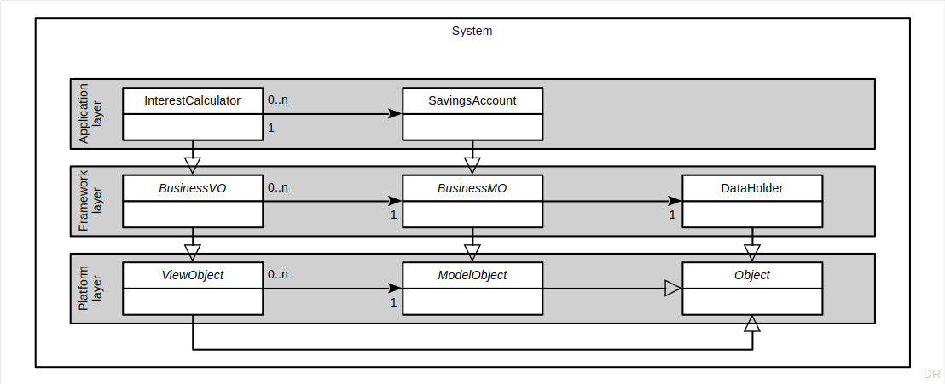
Code Layers

Slide 14
Terminology
System
Component
or service
Boundary or interface
State and
behavior

Slide 15
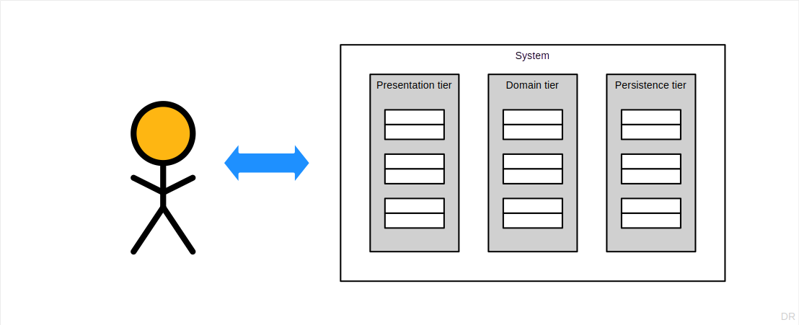
Operator (User) Interaction [1]
[1] Not using the term “user” because it is too broad

Slide 16
System Terminology
A runtime component is
Some runtime data encapsulated (bounded) by an interface
Typically does not stand alone and cannot be deployed independently
A service is a runtime component that
Has business value and maybe composed of other components
Typically does not stand alone (has clients), but can be deployed independently
A system
Is a combination of services and operators (yeah, really)
Has business value and has stakeholders to who this value accrues
Operators are stakeholders but not all stakeholders are operators

Slide 17
Fault
A fault is
A condition that can cause an error
A fault is dormant, if it has not yet caused an error
A fault is active, if it causes an error
A fault
Can be classified by eight independent dimensions [A+04]

Slide 18
Fault Classification
 | Option 1 | Option 2
Phase of creation / occurrence | Developmental | Operational
System boundaries | Internal | External
Phenomenological cause | Natural | Human-made
Dimension | Hardware | Software
Objective | Malicious | Non-malicious
Intent | Deliberate | Non-deliberate
Capability | Accidental | Incompetence
Persistence | Permanent | Transient

Slide 19
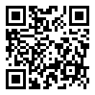
How to Classify the Common Bug? [1]
[1] Also https://forms.gle/DuNNXR2VghcaRHK48

Slide 20
Error
An error is
A state of the system that may lead to a failure
An error is latent, if it has not been detected
An error has been detected, if regular code identifies an erroneous state
An error
Can be categorized by the failures it may cause

Slide 21
Failure
A failure is
An event that transitions the system from correct to incorrect service
A failure
Has a (failure) mode
Can be categorized by four independent dimensions
Domain (content, early timing, late timing, halt, and erratic failures)
Detectability (signaled and unsignaled failures)
Consistency (consistent and inconsistent failures)
Consequences (minor to catastrophic failures)
Can be ranked by severity (consequences)

Slide 22
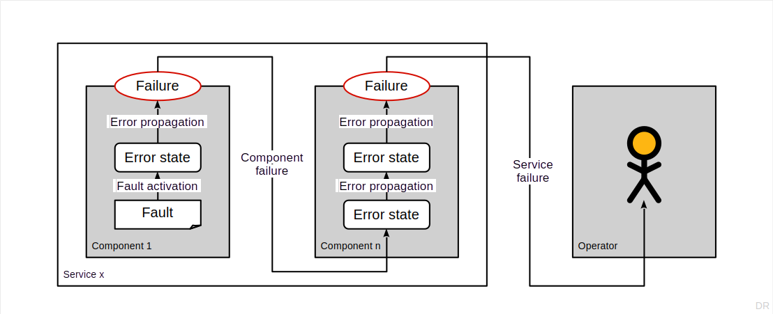
Illustration of Process that Leads to Service Failure

Slide 23
Three Steps to Error Handling
Error detection
Error signaling
Error handling

Slide 24
3. Error Detection

Slide 25
How to Detect an Error (State)
If an error is an erroneous state of the system
You need to explicitly check for that state
Assertions that fail identify an error (state)
Assertions are regular code in normal processing state
Use design by contract

Slide 26
Example Name Instance (= Component) Failure
public insert(i: number, c: string): void {
this.assertIsValidIndex(i);
this.assertIsProperlyMasked(c);
const oldNoComponents: number = this.getNoComponents();
this.doInsert(i, c);
this.assertClassInvariants();
const condition: boolean = this.getNoComponents() == (oldNoComponents + 1);
MethodFailedException.assertCondition(condition);
}

Slide 27
Typical Information to Capture / Gather
Meta information
Error id (instance)
Error type
Error-specific information
Stacktrace
Source objects
Affected objects
Explanatory message

Slide 28
How to Represent Error Information
Error codes
Error objects
Exceptions

Slide 29
4. Error Signaling

Slide 30
How to Signal an Error?
A detected error state needs to be logged and signaled
Transition the system from normal to abnormal program / processing state

Slide 31
Normal vs. Abnormal Processing State
Normal processing state (NPS)
Method performed its services
Control flow returns via return statement
Abnormal processing state (APS)
Method failed to perform service
Control flow returns via raising an exception

Slide 32
Methods for Error Signaling
Using normal control flow (but in abnormal processing state)
Use return statement but include error code in return value
Using abnormal control flow
Raise an exception and include information in exception object

Slide 33
Error Code Conventions
0 = no error
-1 = generic error
1..n = specific error

Slide 34
Return Objects
A return object is
An object that provides both
A possible error code, if any
The actual return results

Slide 35
Error Codes vs. Return Objects vs. Exceptions
 | Pros | Cons
Error codes | Simple | Return values need to be passed back separately
Return objects | A solution if you have no good exception mechanism | Mix normal with abnormal processing state
Exceptions | Separate normal with abnormal processing state | –

Slide 36
5. Error Handling

Slide 37
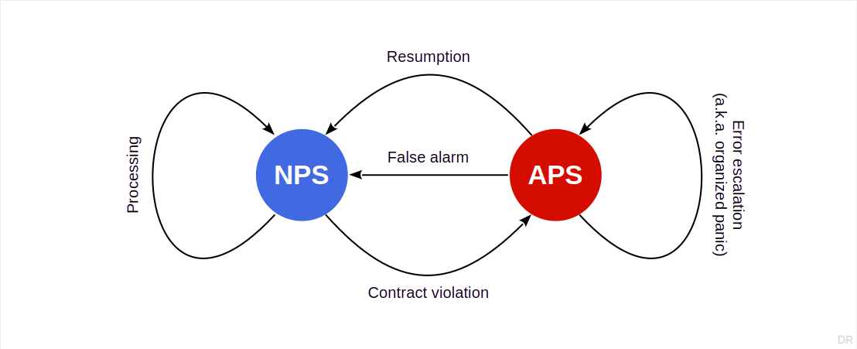
Error Handling State Model

Slide 38
Error Handling
A false alarm is
An erroneously identified error state
Resumption is
When you try again, possibly after fixing something
Escalation (a.k.a. organized panic) is
When you give up and signal the error to your caller

Slide 39
How to Handle Component Failures?
public read(noBytes: number): Int8Array {
let result: Int8Array = new Int8Array(noBytes);
// do something
let tries: number = 0;
for (let i: number = 0; i < noBytes; i++) {
try {
result[i] = this.readNextByte();
} catch(exception) {
tries++;
// Oh no! What @todo?!
}
}
return result;
}
1
if (tries == 3) {
// ignore
}
2
if (tries == 3) {
throw exception;
}
3
if (tries == 3) {
result = {
errorCode: -1,
errorMessage: "couldn't finish"
}
}
4
MethodFailedException.assertCondition(tries < 3);

Slide 40
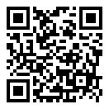
What Should You Do? [1]
[1] Also https://forms.gle/kw7eHQpnUgTLwnU59

Slide 41
How to Escalate an Error
First, clean up
Leave the component in a viable state
Restore component invariants
Release any unneeded resources
Use finally block to ensure this
Then, escalate
Enhance original error information
Keep chaining exceptions

Slide 42
Checked vs. Unchecked Exceptions
Use unchecked exceptions within a component
You also can use checked exceptions, but human psychology suggests that you won’t be able to follow through
Use checked exceptions at a service’s boundary
Typescript does not have checked exceptions, so you may have to find alternative ways of dealing with service boundaries

Slide 43
6. Service Failure

Slide 44
Service Failure
A service failure is a component failure
At the interface to the calling client
Use checked exceptions to signal service failure
Only use exceptions specific to the failure

Slide 45
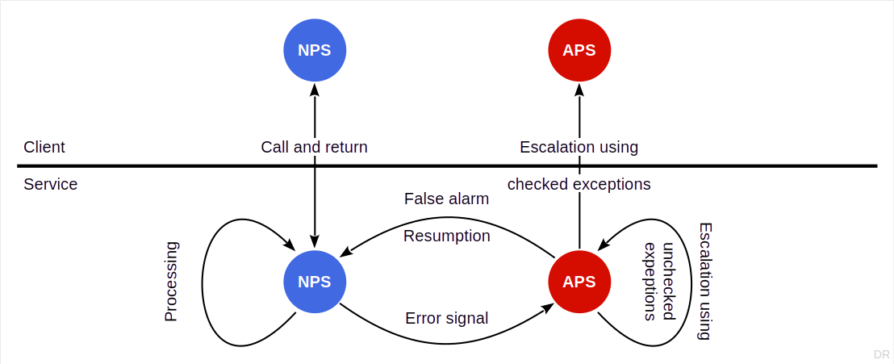
Client / Service Error Handling State Model

Slide 46
Service Failure Exceptions to Use [1]
On the service side, for service failures, use
ServiceFailureException
To be interpreted as a “to check” (checked) exception
[1] JavaScript does not support checked exceptions, hence we have to simulate it

Slide 47
Error Escalation of Failure Signal
On the client side, if you need to escalate a service failure
Wrap the checked exception in an unchecked exception
The game may repeat itself at the next service boundary

Slide 48
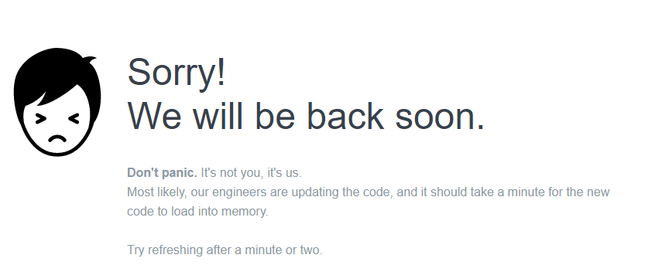
Service Failure at the User (Operator) Interface
Rather than display in text, a checked exception
Convert the error into human-readable form and display it

Slide 49
Homework

Slide 50
Homework
Implement findNodes() for the Node class hierarchy
View a file system as a service with the root node as its interface
View the names as just a component used within the file system
Make the buggy file setup test work as intended
Please see the injected fault in BuggyFile.ts
No need to complete the file implementations
Adapt your previous work to this homework as you see fit
Commit homework by deadline to homework repository

Slide 51
The Final Word on Exceptions
let up: Exception = new Exception("something is wrong");
throw up; // haha

Slide 52
Summary
The common bug
A system model
Error detection
Error signaling
Error handling
Service failure

Slide 53
Thank you! Any questions?
dirk.riehle@fau.de – https://oss.cs.fau.de
dirk@riehle.org – https://dirkriehle.com – @dirkriehle

Slide 54
Legal Notices
License
Licensed under the CC BY 4.0 International license
Copyright
© 2012, 2018, 2024 Dirk Riehle, some rights reserved

